Slide 1
No Homo(phobic): an econometric analysis of our opinions on homosexuality
E413: Adrienne Sands
Notes:
Began with a statement from my friend Todd: “it’s not me who hates gays, its my age race and religion”

Slide 2
Current Attitudes
Homophobia
  intentional or “accidental”
  Sin not the sinner?
Studies on the prevalence and motivations of negative opinions
  PEW Research Center Poll
We care because…
  “prevalent social justice issue of current decade”
  Don’t Ask Don’t Tell; Discrimination Bill
  Future policy
Notes:
Homophobia is a range of negative attitudes and feelings towards homosexuality and people identified or perceived as being homosexual. Definitions^{[1][2][3]} refer variably to antipathy, contempt, prejudice, aversion, and irrational fear. Homophobia is observable in critical and hostile behavior such as discrimination^{[1][2]} and violence on the basis of a non-heterosexual orientation.
Paper: Homophobia: Comments or actions marked by negative attitudes toward gays and lesbians, whether observable/intentional or not.
Opinions of race, gender, class, and sexuality
Self—reported
Problems: Nonresponse Bias, Subjective answers

Slide 3

Prior Research
General decrease in homophobia since 1970s
  Increase in level of relevance
Prevalent outlets of homophobia: arguable
  Morality of homosexuality
  Gay Marriage
  Gay families/ adoption
Attitudes Gays vs. Lesbians
    “Public Attitudes towards Gays and Lesbians”
Notes:
Increase in level of relevance: “discriminated minority group of the decade”

Slide 4
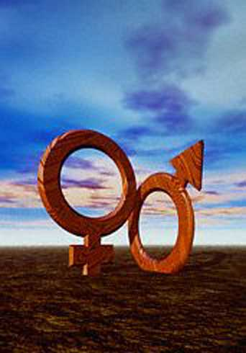
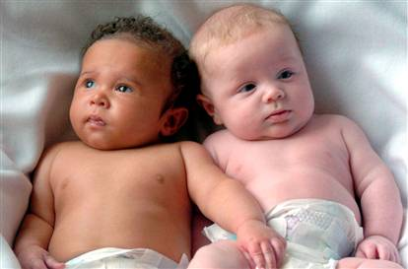
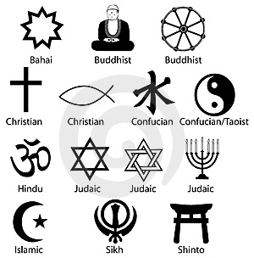
Important Independent Vars
Gender
  Women more accepting of homosexuality
  Gender significantly affects acceptance of gay marriage (more than marital status and residence)
Race
  Whites more accepting of gays than black individuals
  Significant ties to religion (“Black Church”)
  After controlling for religion, blacks equally accepting of homosexuality
Religion
  Effect by race confounded by religiosity

Slide 5
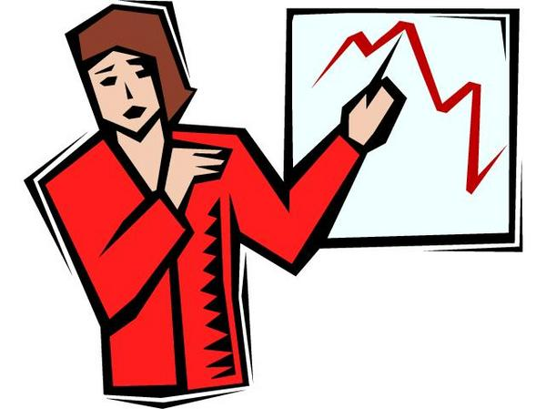
Data
Pew Research Center Poll
  October News Interest Index on Politics, Public Life, and Religion (2003)
Total available sample: n=1516
  Regressions: n=1212 after adjustments
Get rid of those scores of 9!
Notes:
For each scaled opinion question, a score of 9 was given if the respondent refused to answer the question or did not understand

Slide 6
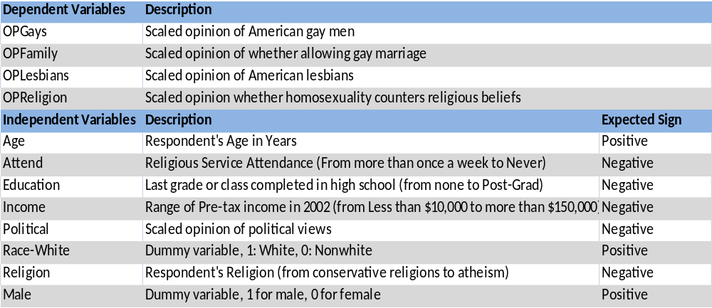
Expected Signs
Interpretation of expected signs
Positive: i.e. “The older a respondent is, the more homophobic they are”
Negative: i.e. “For every increase in scaled answer on the survey regarding ______________, the more homophobic the respondent is.”
Notes:
(If positive, increase in var = increase in homophobia)

Slide 7
But, we can’t quite use OLS!
Why?
  Ordinal Regression applicable
    Scores are scaled “Strongly Disagree to strongly agree”
  OLS estimations had very low R^2 terms and most failed the Ramsey for incorrect functional form
    OLS regression included in paper
    Simplistic regression model: integer scoring
So… Ordered Logistic Regression!
Notes:
(strongly agree vs. agree vs neutral may not be even interval)
Assumes categories are equally spaced
Problematic because assumptions of OLS violated with non-interval outcome variable

Slide 8
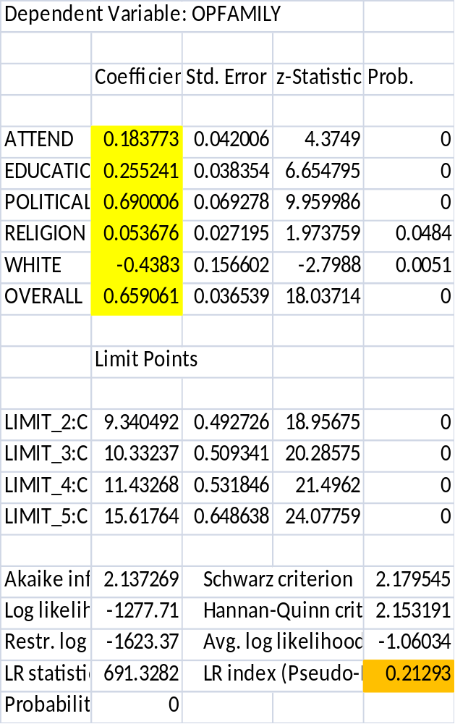
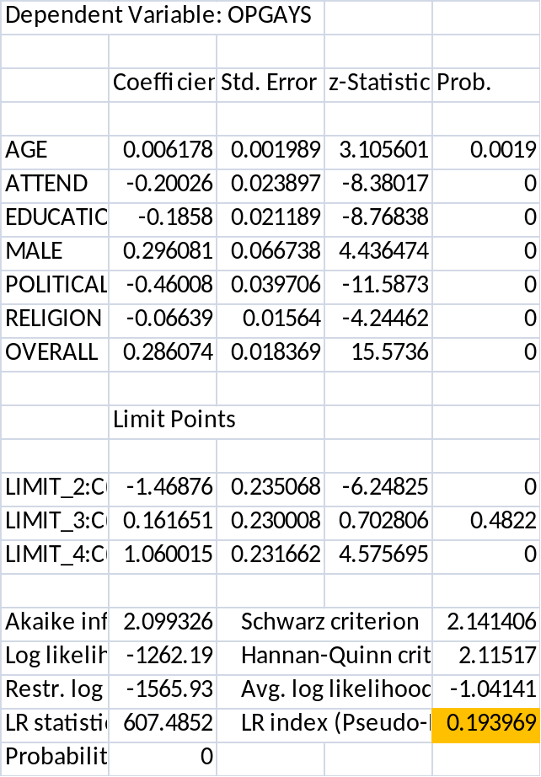
Example Regression Output
Expected Signs (Again!)
Age | Pos
Attend | Neg
Education | Neg
Male | Pos
Income | Neg
Political | Neg
Race-White | Pos
Religion | Neg
Expected Signs Spot on!
THEORETICALLY WRONG

Slide 9
Conclusion
Attitudes toward homosexuality depend on the issue
  Separate regressions for gay marriage, morality of homosexuality, and opinions of gay families
Highly educated, political liberals who are atheist and white are less homophobic
Income, age, gender, frequency of church attendance insignificant in most regressions
Not a very fitting regression, but oh well…
Notes:
Tried to do “overall” which was sum, but didn’t get R^2 higher than 0.08
Age and gender significant in the opinion of gays, but not of lesbians

Slide 10
“it’s not me who hates gays, its my age race and religion”
Actually, Todd, it depends on the issue
If its your general opinion of gays, then yes, it’s your age, church attendance, education, maleness, political affiliation or religion.
If that’s not the issue, then maybe not.
Or it could just be you (ε_{Todd})

Slide 11
Further Study
Excluded variables: Measures of racism, sexism, classism; sexuality; dummy variable for WGSS classes
Accuracy of questionnaires for determining prejudices
Rephrase questionnaire for less ambiguity
  Major cause of non response bias
Stigma of term “homosexuality” and “gay” versus “queer” for different age groups

